Slide 1
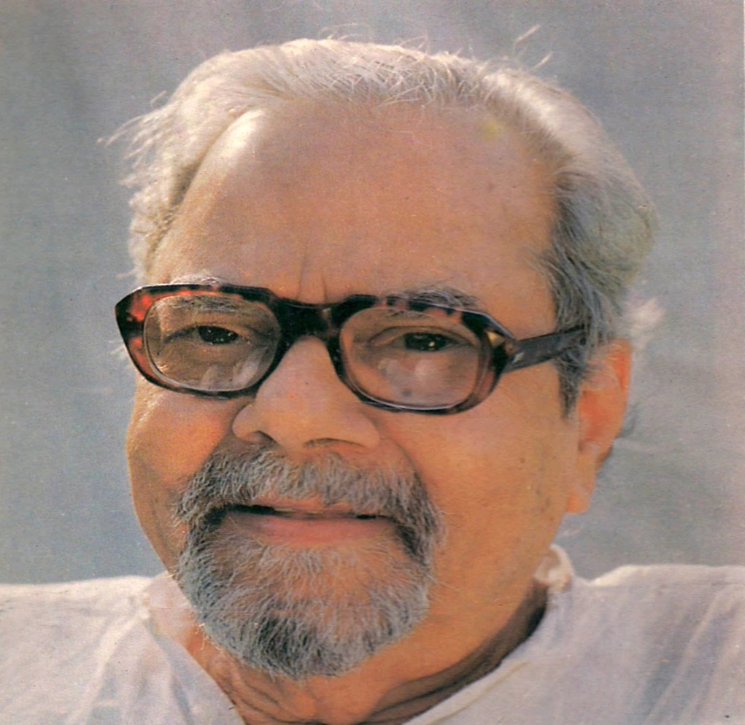
A TRIBUTE TO PROFESSOR
DAYA KRISHNA
1924 - 2007

Slide 2
Former Professor and Head, Department of Philosophy, university of Rajasthan, Jaipur from 1963-1984
Director, Special Assistant Programme in Philosophy, University of Rajasthan, Jaipur
Former Pro-Vice chancellor, University of Rajasthan, Jaipur

Slide 3
MEMBERSHIP OF THE LEARNED SOCIETIES
Member of the international committee constituted by the international Council of Philosophy and Humanities Studies, UNESCO, to judge the best articles submitted for the International competition sponsored by its journal- DIOGENES. The Committee consisted amongst others, of Andre Malraux, Lous Mumford, D.W. Brogan.
Member UNESCO Project on Research Trends in humanities and social Sciences.( Special consultant for Philosophy in South Esat Asia and Japan).
Member Editorial board-DIOGENES.
Consultant, Humanities Project, East West Centre , HAWAII
Consultant , UNESCO Anthology on Violence.

Slide 4
6. Ex-Member, Advisory Body, Indian Institute of Advance Study, Shimla
7. Ex-member, Philosophy panel, university Grants Commission.
8. Member, Research Project Committee, Indian council of Philosophical Research , New Delhi
9. Ex-member, Governing Body, Indian Council of Philosophical Research , New Delhi
10. Editor, Journal of Indian Council of Philosophical Research , ( JICPR), New Delhi
11. Ex-Member, General Council, Sahitya Academy, New Delhi

Slide 5
12. Member, Editorial Board, “ Philosophy , East and West”, Hawaii
13.Ex-member, Board of Governors, Tibetan Institute for Higher Studies, Sarnath
14. Member Governing Body, Project of History & Civilization, New Delhi
15, Member Governing Body, Centre for Studies in Civilizations, New Delhi
16. Member Publications Advisory Committee, Indian Council of Philosophical Research , New Delhi

Slide 6
PARTICIPATION IN CONFERENCES/SYMPOSIA HELD IN INDIA AND ABROAD
East –West Philosopher’s Conference- Canberra, Australia ( Member, Indian delegation to the Conference) 1957
International Conference on Representative government and Public Liberties in New States of Asia and Africa, Rhodes Island, Greece-1958. Participant Member contributed the opening paper for the conference on “What is Democracy” ? with Bertrand de Jouvenel.
UNESCO Preparatory Meeting to plan for a project on Investigation of Research Trends in Humanities and social Sciences. Paris, 1964
Fifth East-West Philosopher’s Conference, Honolulu, Hawaii-1969 ( one of the five persons invited to write key papers for Conference on which week long discussions were to be held).
International seminar on Philosophy- Theory and Practice, Madras-1970

Slide 7
International conference organized by the Institute of Inter- cultural Research, Zurich-1973
Technology and cultural Values in South East Asia, Bangkok-1974
International Conference of UNESCO’s Advisory Body on Interdisciplinary Research in the social Sciences and Humanities, Paris, April 1976
Observer-Participant on behalf of the International Council of Philosophy and Humanistic Sciences and International Science Education at International Symposium on Science and Technology for Development. Meeting held at Singapore-1979
International conference on the Place of Human Rights in Cultural and Religious Traditions, Bangkok-1979
International Seminar on “ Trsans-cultural-Universals”. Canada-1983
Meeting of experts on Teaching and Research in Philosophy in Asia, Bangkok, Thiland 1983

Slide 8
Conference on “ God : The Contemporary discussion”. San Juan. Puetrto Rico, USA-1984
14. Workshop on “ Representations on Self in Literature”, East –West centre, Hawaii-1984
15. Seminar on “Comparative Philosophy”. Society for Asian and comparative Philosophy, Hawaii-1984
16. Meeting of the International council of Philosophy and Humanistic Sciences, Bangkok-1984
17. Special Invitee to give one of the Pleanary address east the International Conference on thinking and conducted a special workshop on it. ( January-1987)
18. Sixth East-west Philosophers’ Conference, Hawwaii-1989
19. Convivum -2 at University of Liverpool, Liverpool-1990
20. Colloquium on culture & Rationality . Mt. Abu.-1991
21. convivum -3 at New Delhi-1993
He also attended conferences in Russia and China

Slide 9
MAJOR FELLOWSHIPS RECEIVED
Rockefeller Foundation- Visiting Fellow 1960-62 ( one and half year)
Senior Fellowship of East-West Centre- Hawaii 1962-1963
Visiting Professor, University of Hawaii, USA -1970 9 for one year)
Visiting Professor, Carleton College, USA-1971
National Fellowship- Indian council of Philosophical Research, New Delhi ( May 1987-Dec.1989)
National Fellowship- Indian council of Philosophical Research, New Delhi ( jan. 1990-Dec.1991)
Professorial Fellowship, PHISPC project ( Nov.1992-Nov.1998)

Slide 10
AUTHORSHIP OF BOOKS, MONOGRAPHS ETC.
The Nature of Philosophy, Calcutta, Progressive Publishers.1956
Planning, Power and Welfare. Delhi :Congress for Cultural Freedom, 1959
Considerations towards a Theory of social Change. Manaktala , Bombay, 1965
Social Philosophy : Past and Future , Shimla, Institute of Advanced study, 1969
Modern Logic : Its Relevance to Philosophy (Ed.) Delhi, Impex India 1969
Indian Education Today : Prospects and Perspectives (Ed.) Jaipur, Rajasthan University press,1973
Contemporary Philosophical Problems : Some Classical Indian Perspective (Ed.) Daya Krishna and A.M.Ghose, Poona, Indian Philosophical /quarterly Publications.1978
Political Development : A Critical perspective, New Delhi, Oxford University Press,1979
Gyan Mimansa ( Hindi), Jaipur, Rajasthan Hindi Granth Academy

Slide 11
Paschmi Darshan Ka Itihas ( Hindi) (Ed.) in two Vols. Jaipur, Rajasthan Hindi Granth Academy 1989
Philosophy of Kalidas Bhattacharya ( Ed.) Poona, Indian Philosophical quarterly Publications. 1977
Philosophy of J.N.Mohanty ( Ed.) Dayakrishna and K.L.Sharma , ICPR, New Delhi 1991
Development Debate : Fred W. Riggs and Daya Krishana. Printwell publishers, Jaipur, 1987
India’s Intellectual Traditions : (Ed.) ICPR, Motilal Banarsidas, New Delhi 1987
The art of Conceptual Explorations in a conceptual Maze over Three Decades, ICPR with Munshiram Manoharlal Publishers Pvt.Ltd. New Delhi 1989
Samvad : A Dialogue between Two Philosophical Traditions ( Ed.) Daya Krishana et a.l., ICPR, New Delhi

Slide 12
Indian Philosophy : A counter Perspective, Oxford University Press New Delhi 1991
Problematic and Conceptual Structure of Classical Indian Thought About Man, Society and Polity, Oxford University Press new Delhi
Indian Philosophy : A New approach , Indian Book Centre New Delhi 1997
Prolegomena to any Future Historiography of Culture and Civilization , PHISPC, New Delhi 1997
History, Culture and Truth : Essays Presented to D.P,Chattopahyaya, ( Ed.)DayaKrishna et al., Published by Munshiram Manoharlal, New Delhi,1999
Perspectives in Indian Philosophy, Rawat publications, Jaipur,2000
Bhakti , Daya Krishna et al., ICPR ,2000

Slide 13
Discussion and debate in Indian Philosophy : Vedanta, Mimamsa and Nyaya, ICPR, New Delhi 2004
Nyaya Sutras – a New Commentary on old Text, Satguru Publications/ India Book Centre, New Delhi 2004
Contrary Thinking (Ed.) Daya Krishna et al., Oxford Press,2011
Development of Indian Philosophy from Eighteenth Century onwards: classical and Western (Ed.) DayaKrishna et al., Published by Munshiram Manoharlal, New Delhi 2011.

Slide 14
ON POLITICAL SCIENCE BOOKS AND ARTICLES :
BOOKS :
Political Development : A Critical perspective, New Delhi, Oxford University Press,197
Development Debate : Fred W. Riggs and Daya Krishana. Printwell publishers, Jaipur, 1987
“Some Suggestions towards the formation of Political Index Numbers”, Le Contrat Social , Paris September 1958
“What is Democracy” ( a paper written for the International Seminar on Representative Government and Public Liberties in the New states , held in Isle of Rhodes, Greece, Oct.1958)
articles :

Slide 15
“ Des Valueres Essentielles en Politique”, Le Contrat Social , Paris , July 1960
Democracy and traditional Values in B.N. Verma ( Ed.) Asia Publishing House, Bombay, 1962-63.
“ Political Thought in the U.S. : A Case Study of Academic Escapism”, Quest, sept.-Oct.1972
“The Concept of Revolution : An Analysis”, Philosophy East and West, Hawaii, July 1973
“ Concept of Political Development in American Political Science in the Sixtties”, in Joseph Fischer ( Ed.) Foreign values and South East Asian Scholarship, University of California Press,1973

Slide 16
“ Shall We Be Diffracted? A Critical comment on Fred Riggs’, Prismatic Societies and Public Administration” Administrative Change, June 1974
“Contemporary India : A crisis of Identity and Dilemmas of Development “ Quest, Sept-October,1976
“ Towards a Saner view of Development ; A comment on Fred W.Riggs’s comments, Administrative Change, 1976
” Some Reflections on Professor Riggs’s Clarification on Development” Administrative Change, 1979
U.S. Iran Conflict and Global Intellectual Community : Some Unasked Questions; Economic and Political Weekly, June 1998
Political Science VS Political Reality , Studies in Humanities and social Sciences, vol.7, No.1, 2000
The New Tribal States : Can they survive Modern World ; Economic and Political Weekly, nov.2000

Slide 17
PAPERS ON PHILOSOPHY= 117
PAPERS ON SOCIOLOGY = 11
PAPERS ON ECONOMICS= 12
PAPERS ON LITERATURE = 4
REVIEW PAPERS =8
MISCELLANEOUS PAPEERS=2
OTHER PAPERS=5
THANKS
DR. K.L.SHARMA

Slide 18
IN 1986 DR. K.L.SHARMA ORGANISED A 3 DAY SEMINAR IN LUCKNOW
ON THE PHILOSOPHY OF
PROFESSOR DAYAKRISHNA
THE SEMINAR WAS FINANCED BY
INDIAN COUNCIL OF PHILOSOPHICAL RESEARCH, ( ICPR) NEW DELHI

Slide 19
